Slide 1


Cogniti Advisory

Slide 2
About us
We are a top-tier award winning data analytics agency with over 15 yrs. of experience in the investment advisory industry.

Slide 3
How to invest in Athens Airbnb
01
Regions
02
How to boost your earnings
03
Seasonality
04
Key Takeways
Which neighbourhoods are promising to invest in
Characteristics to boost your occupancy rate and income
When is the time to increase listing’s price
Recommendations and next steps
Data comprises info between 2010 and 2022

Slide 4
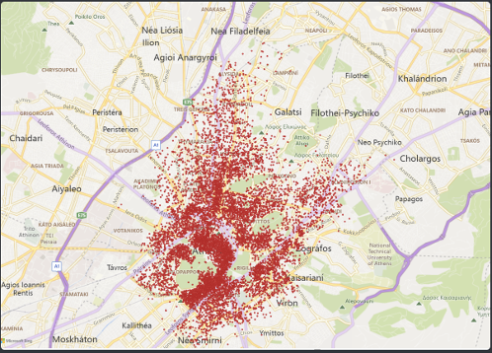
Active Airbnb Listing

Slide 5
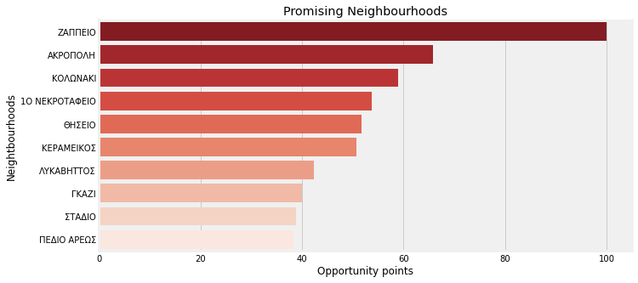
Promising neighbourhoods
Opportunity based on # of listings and avg. price per night
Low competition
High avg price

Slide 6
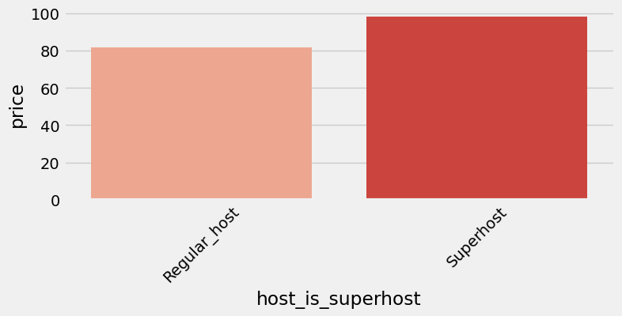
How to boost your listing
Invest effort into becoming a superhost
Increase your earnings by up to 20%

Slide 7
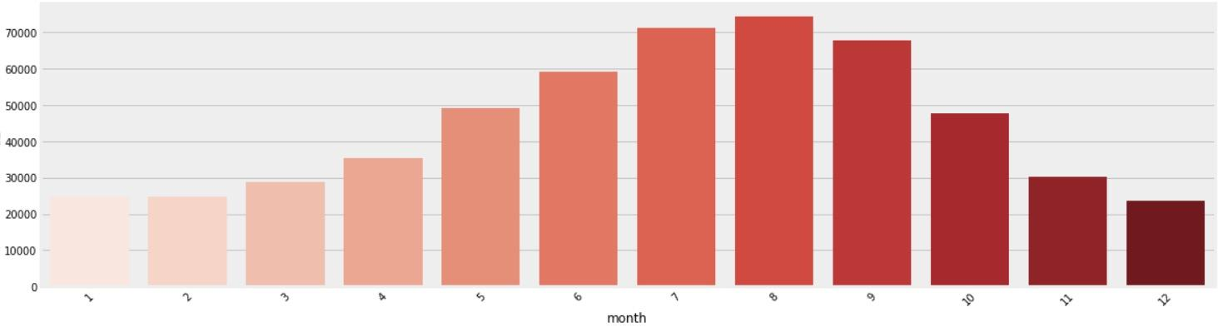
Seasonality
Increase listing’s pricing during summer period
Summer period is really hot in terms of occupancy

Slide 8
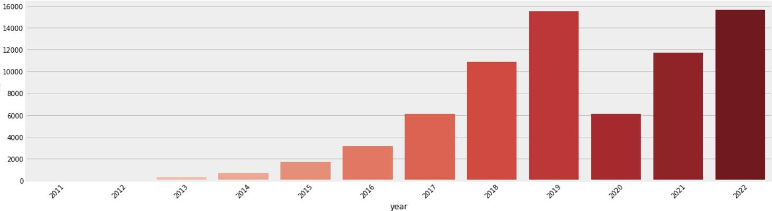
Occupancy rate
Increasing demand in Athens
Covid-19 restrictions
Promising market conditions ahead

Slide 9
Next Steps
Opportunities
Seasonality
Invest now
Summer is your friend
In areas like Zapeio, Akropoli & Kolonaki
Increase price during summer where occupancy is high
Hosting
Keep investing
Become Superhost
High response rates & ratings increase your earnings

Slide 10

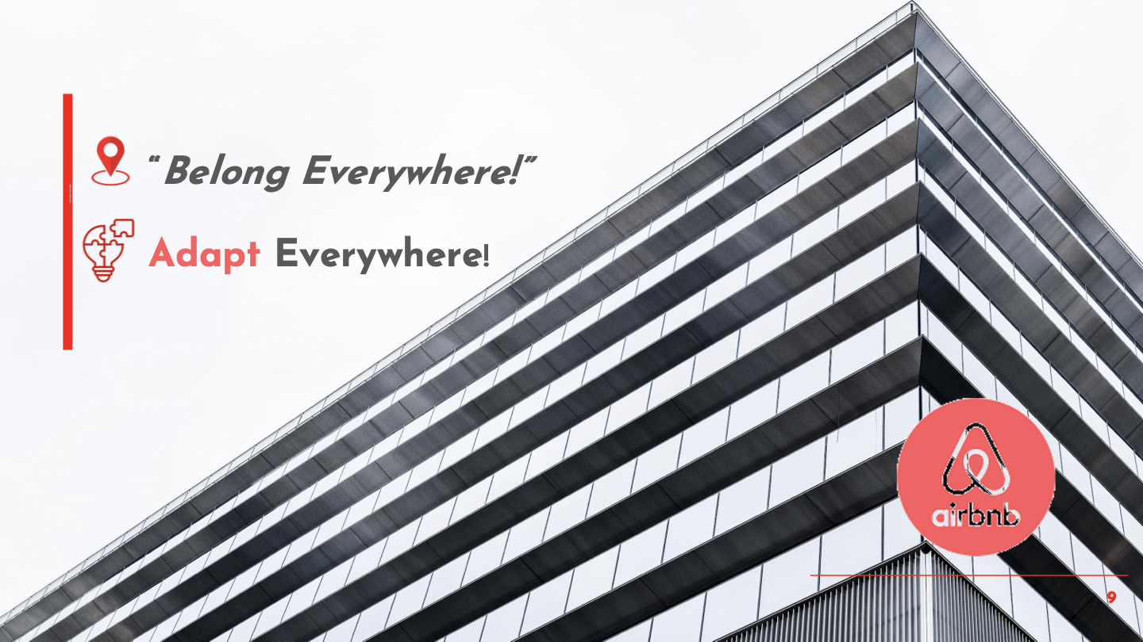
Cogniti Advisory
Thanks!
Do you have any questions?
youremail@freepik.com
+91 620 421 838
yourcompany.com
Please keep this slide for attribution

